Slide 1
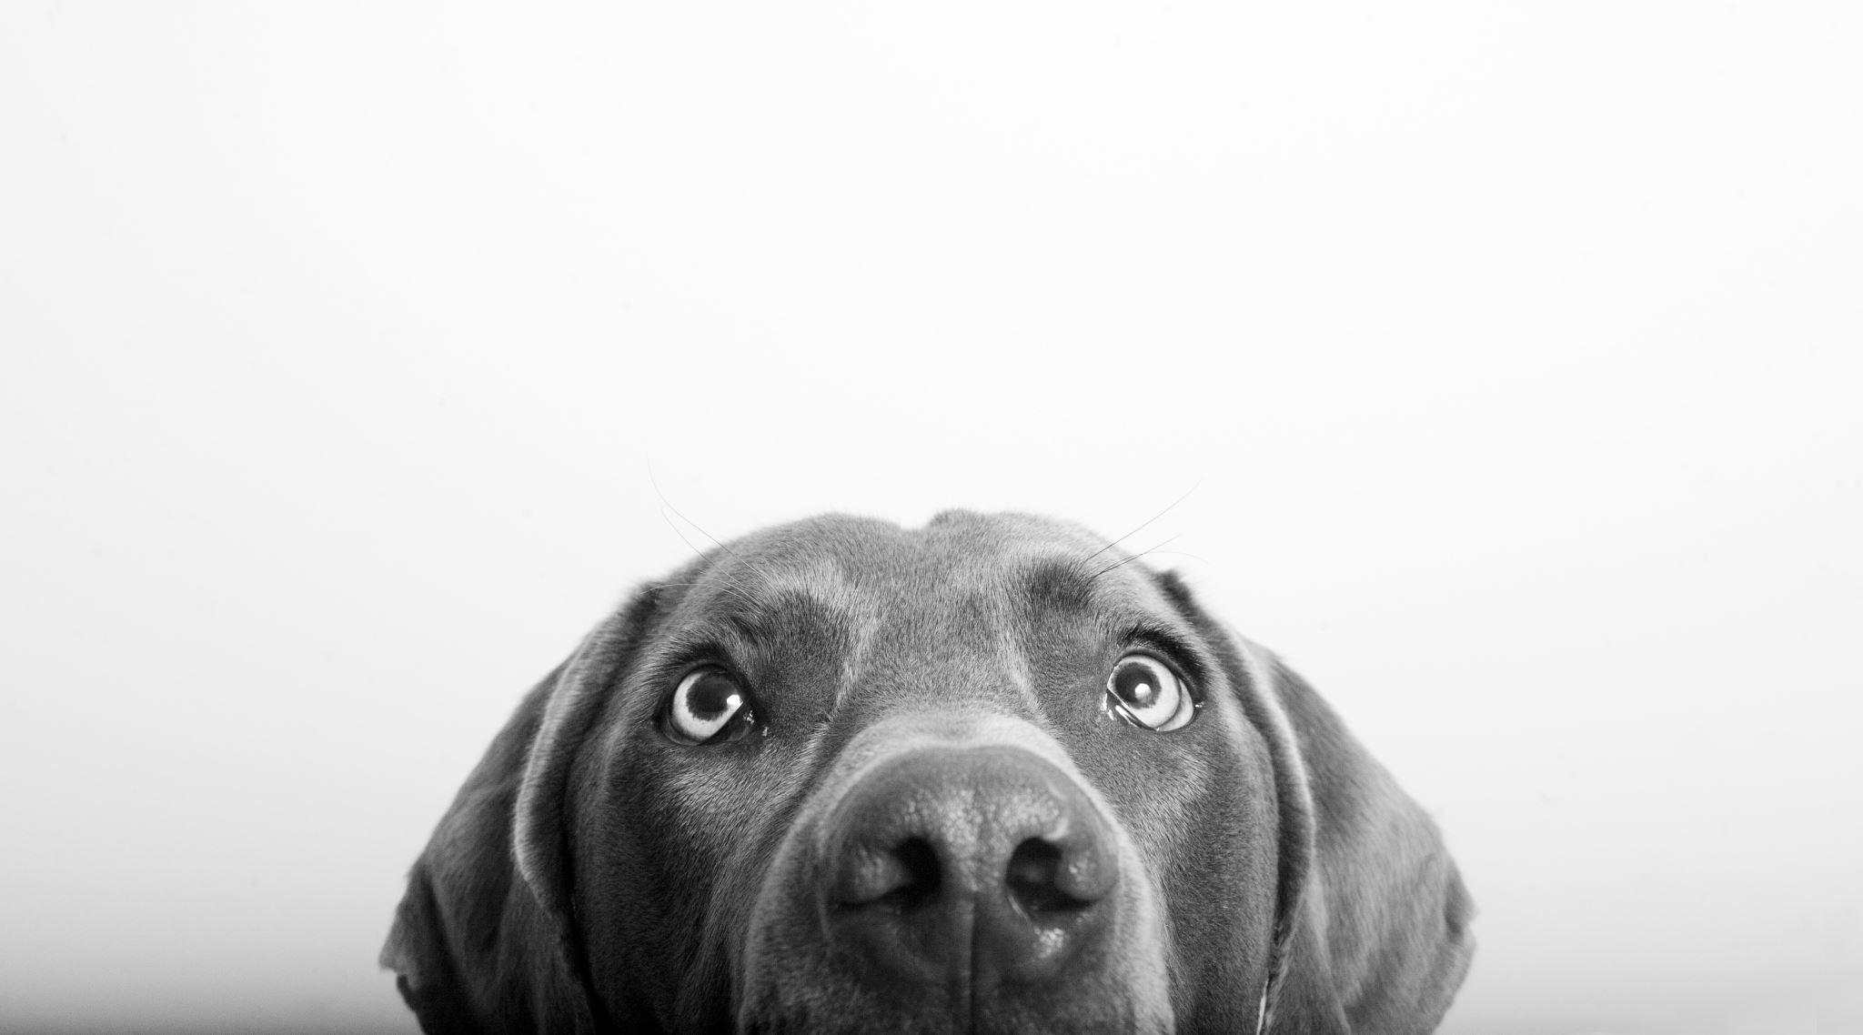
within-host canine h3n2 project
Canine samples
07/22/2025

Slide 2
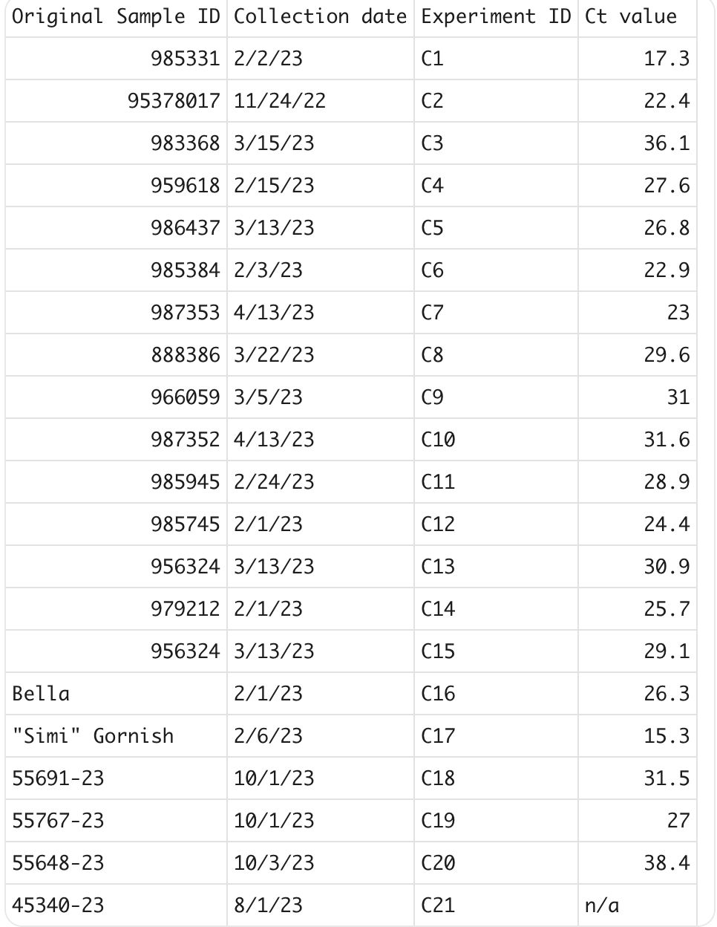

Slide 3
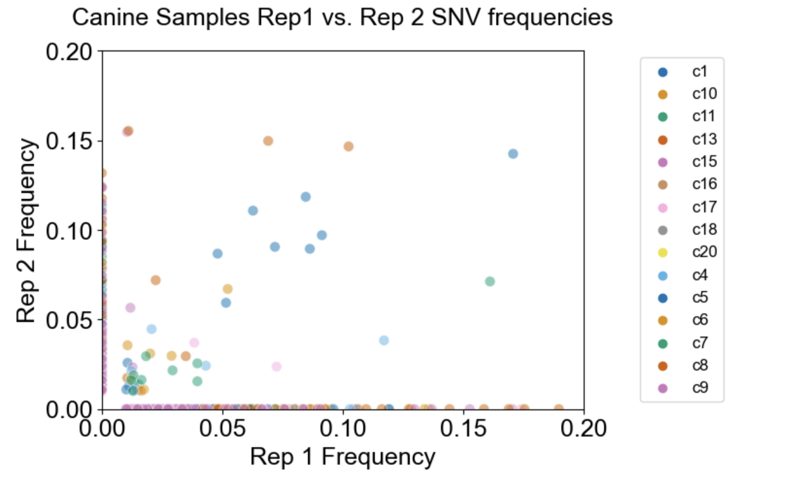
57 shared variants between replicates

Slide 4
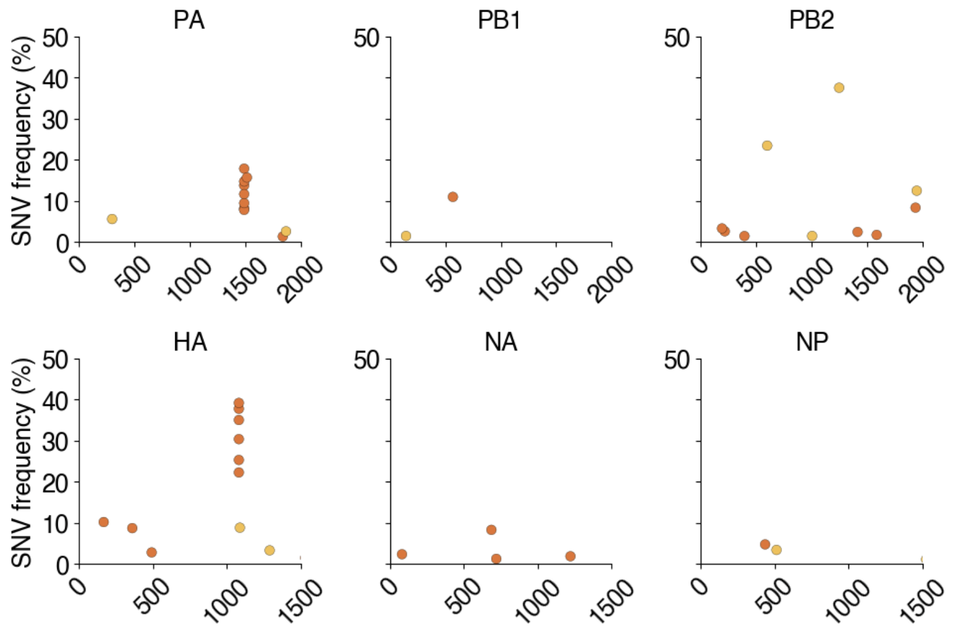
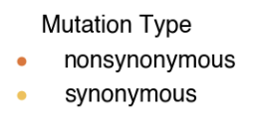
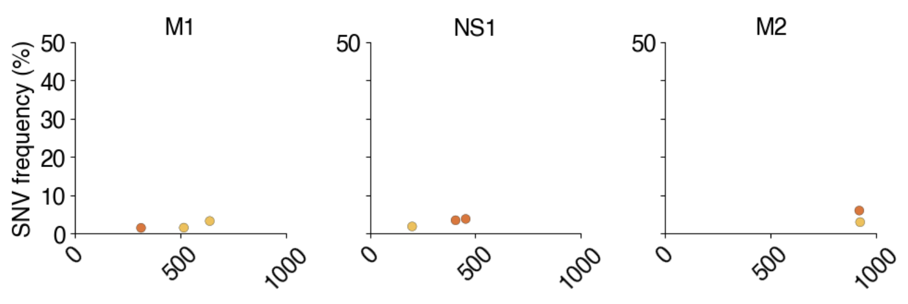
Shared SNVs between replicates by gene

Slide 5
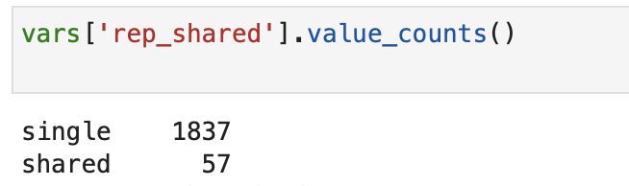
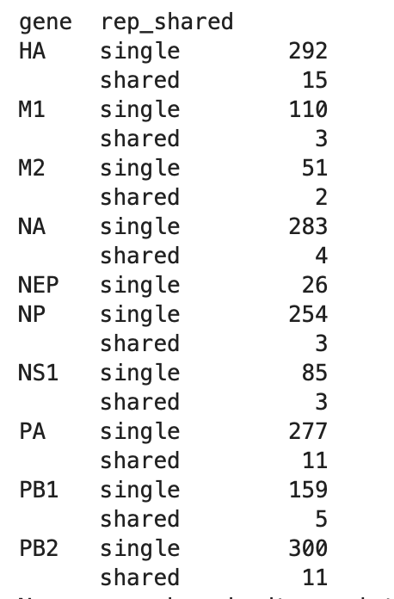

Slide 6
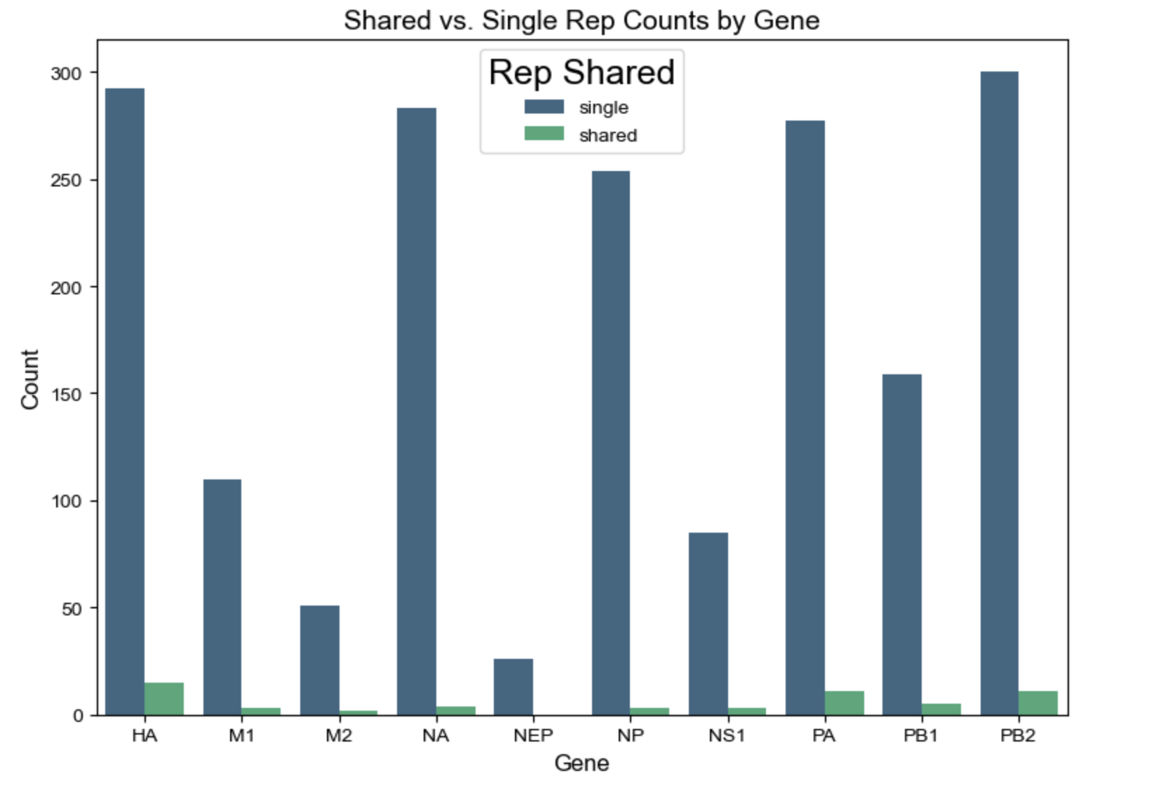

Slide 7
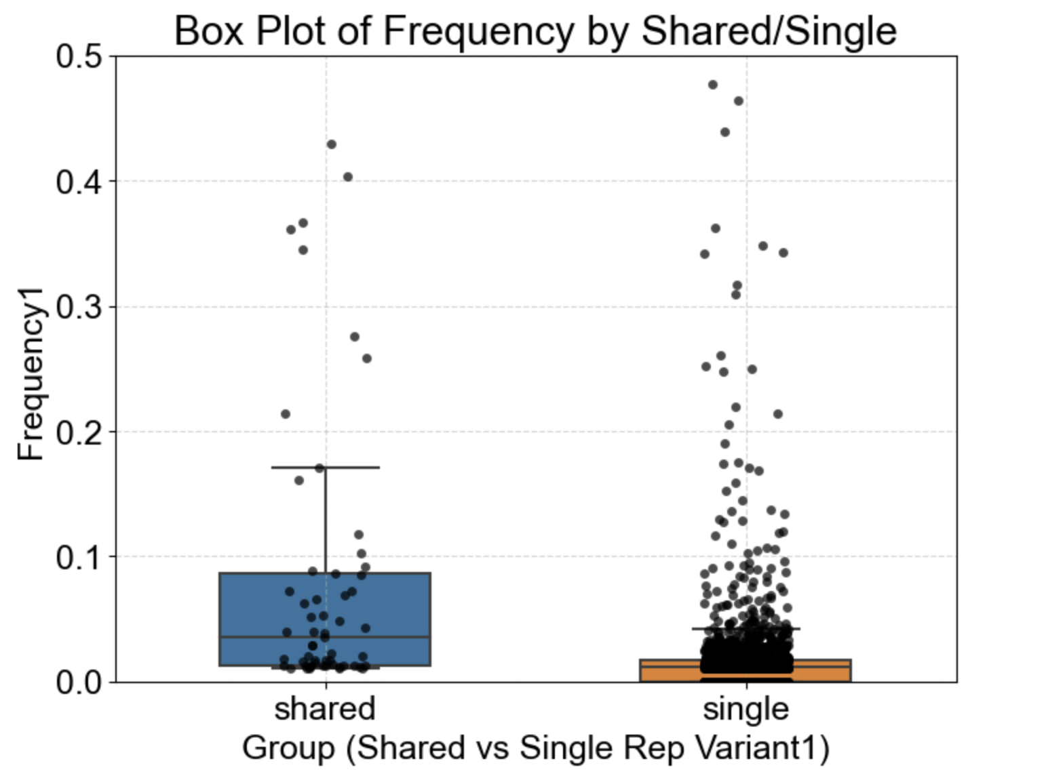
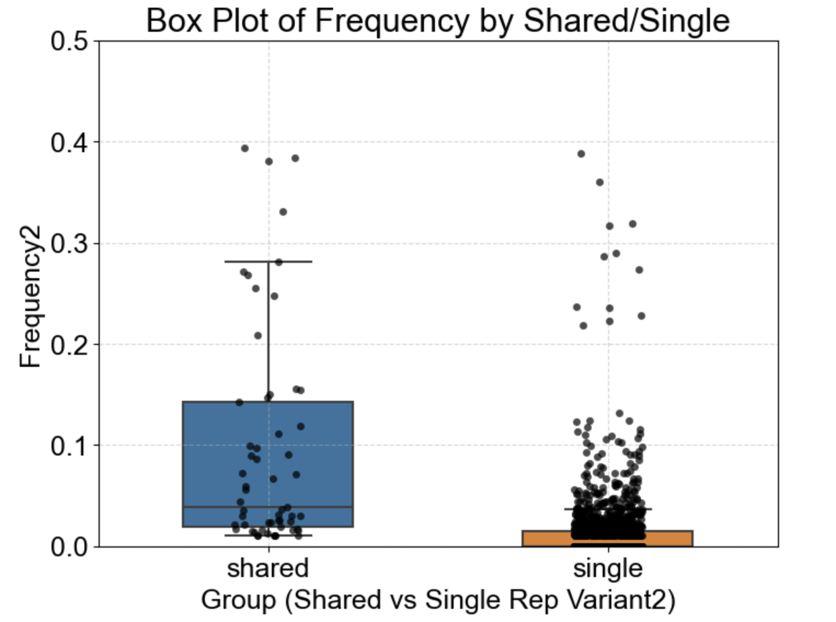
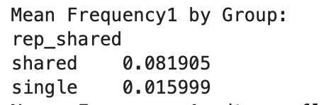
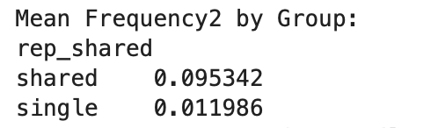
Frequency of variants per replicate
Notes:
stock

Slide 8
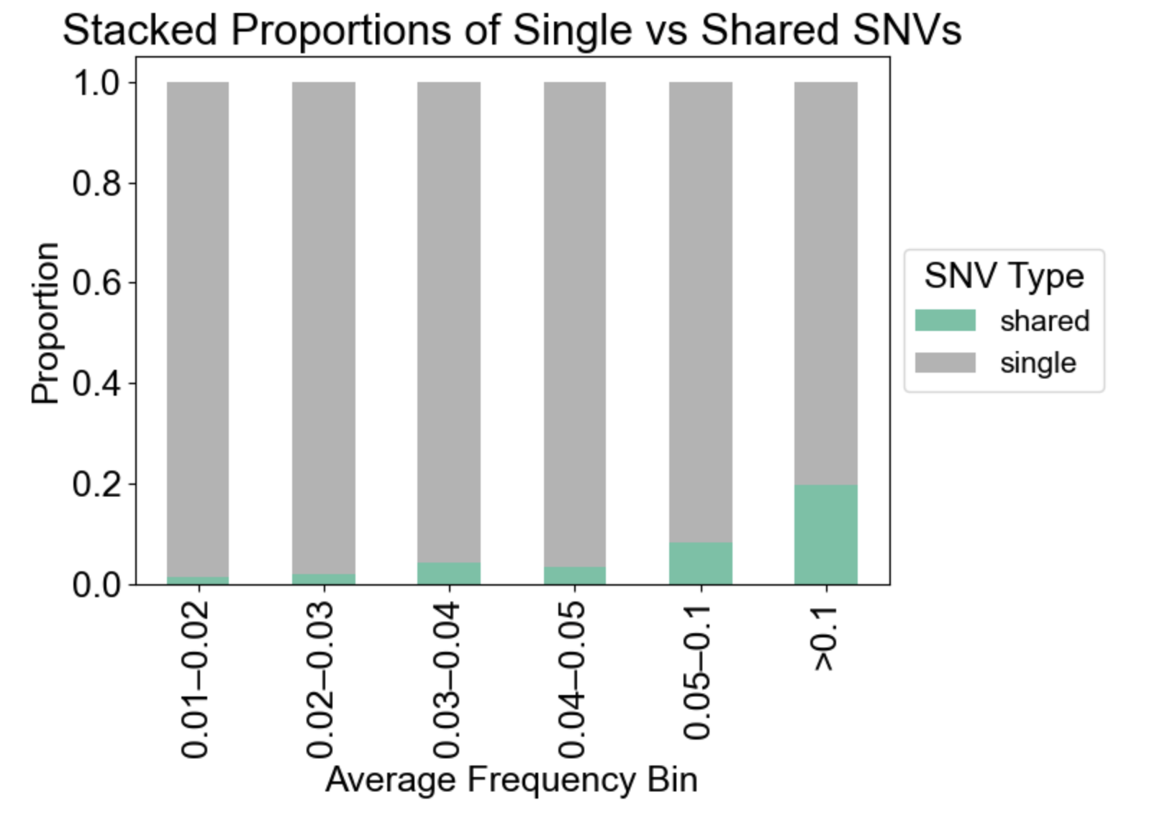

Slide 9
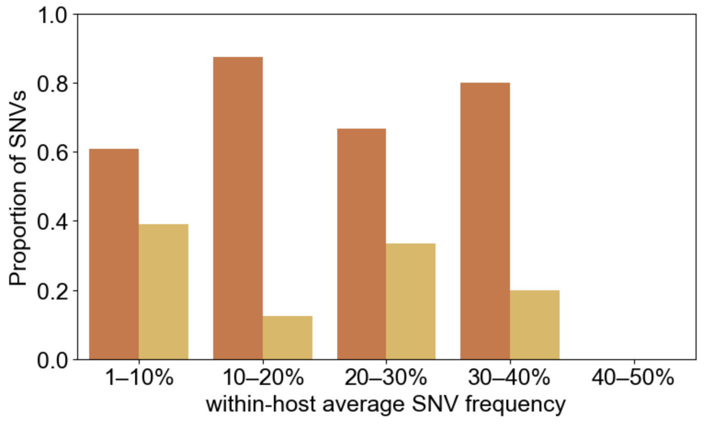
SNVs between replicates
nonsyn
syn

Slide 10
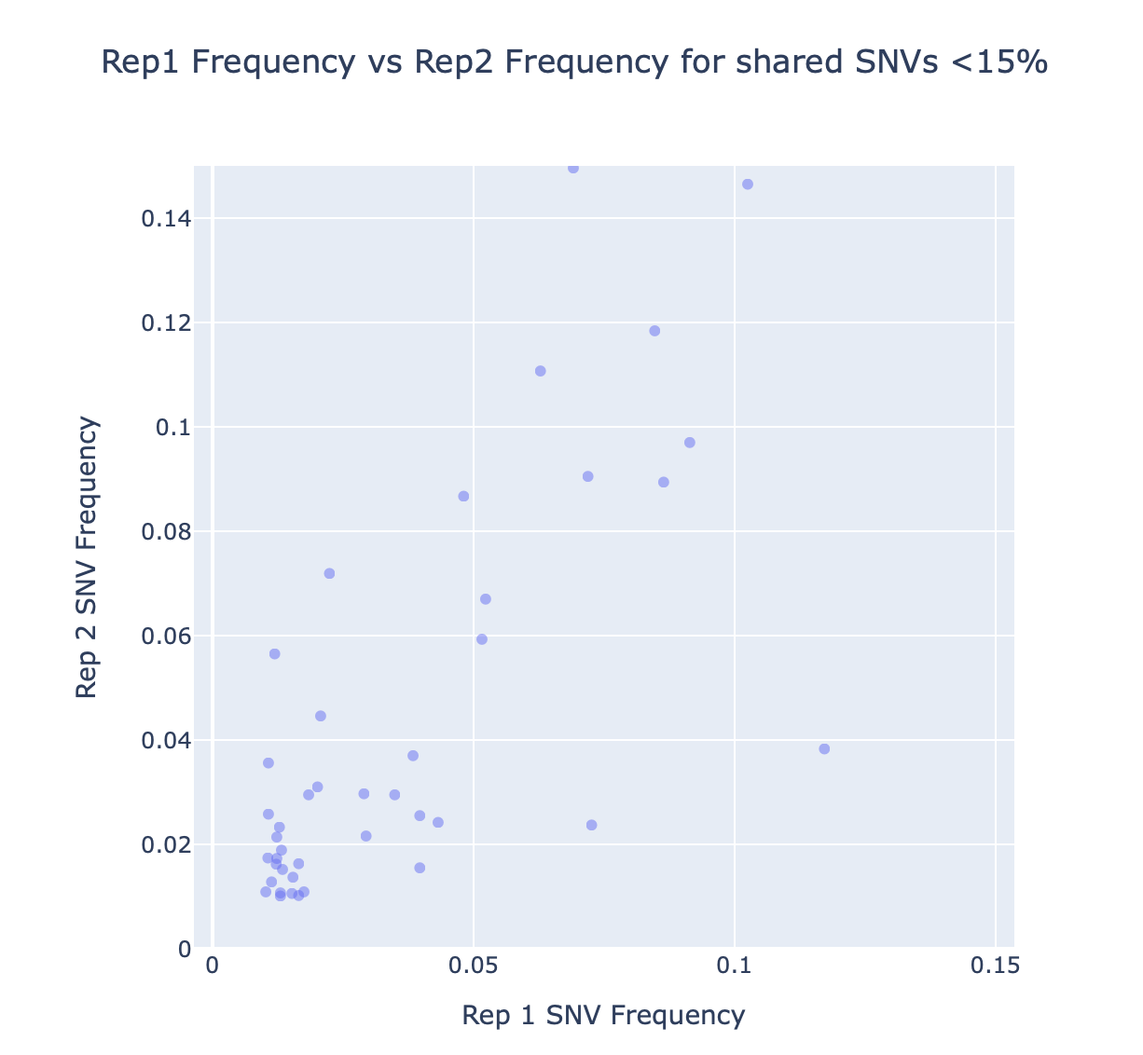

Slide 11
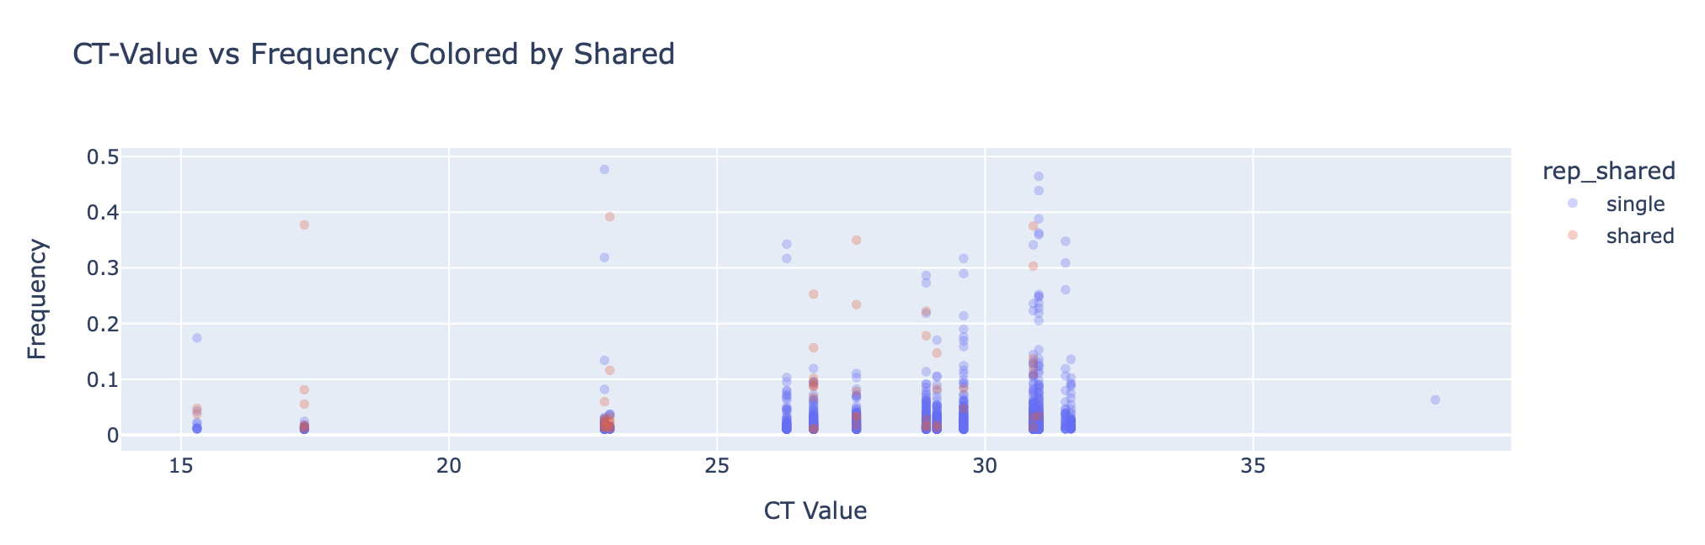
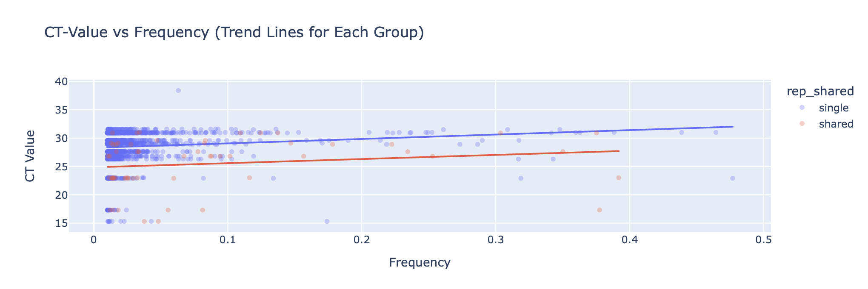

Slide 12
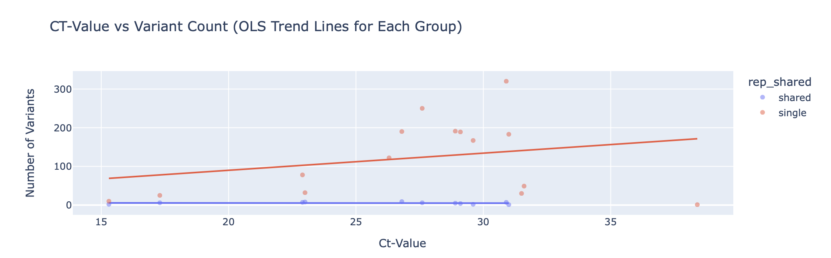
No correlation between ct value and shared variants

Slide 13
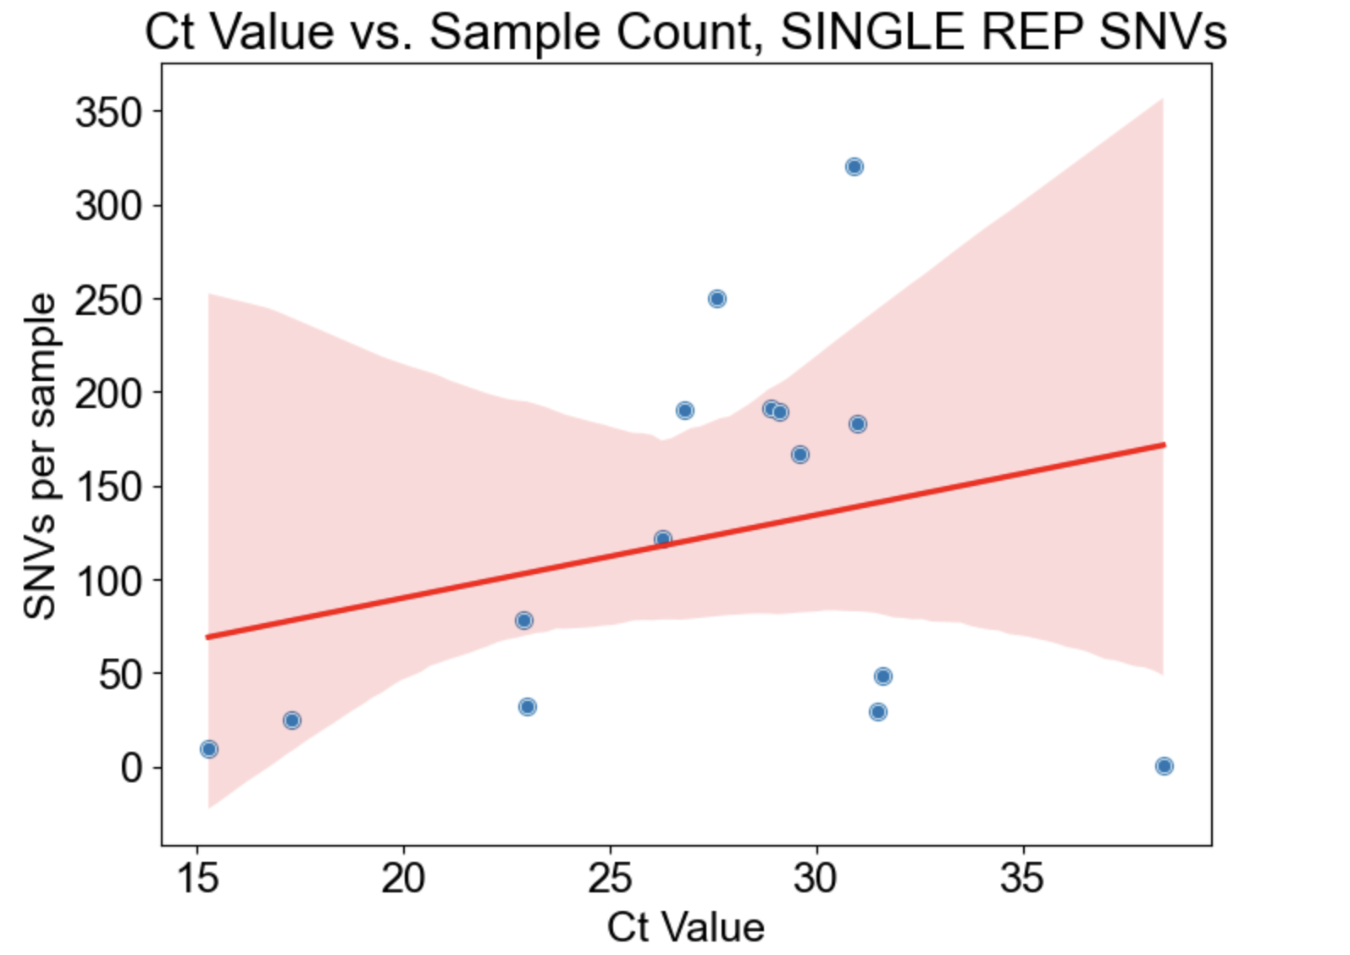
Positive correlation

Slide 14
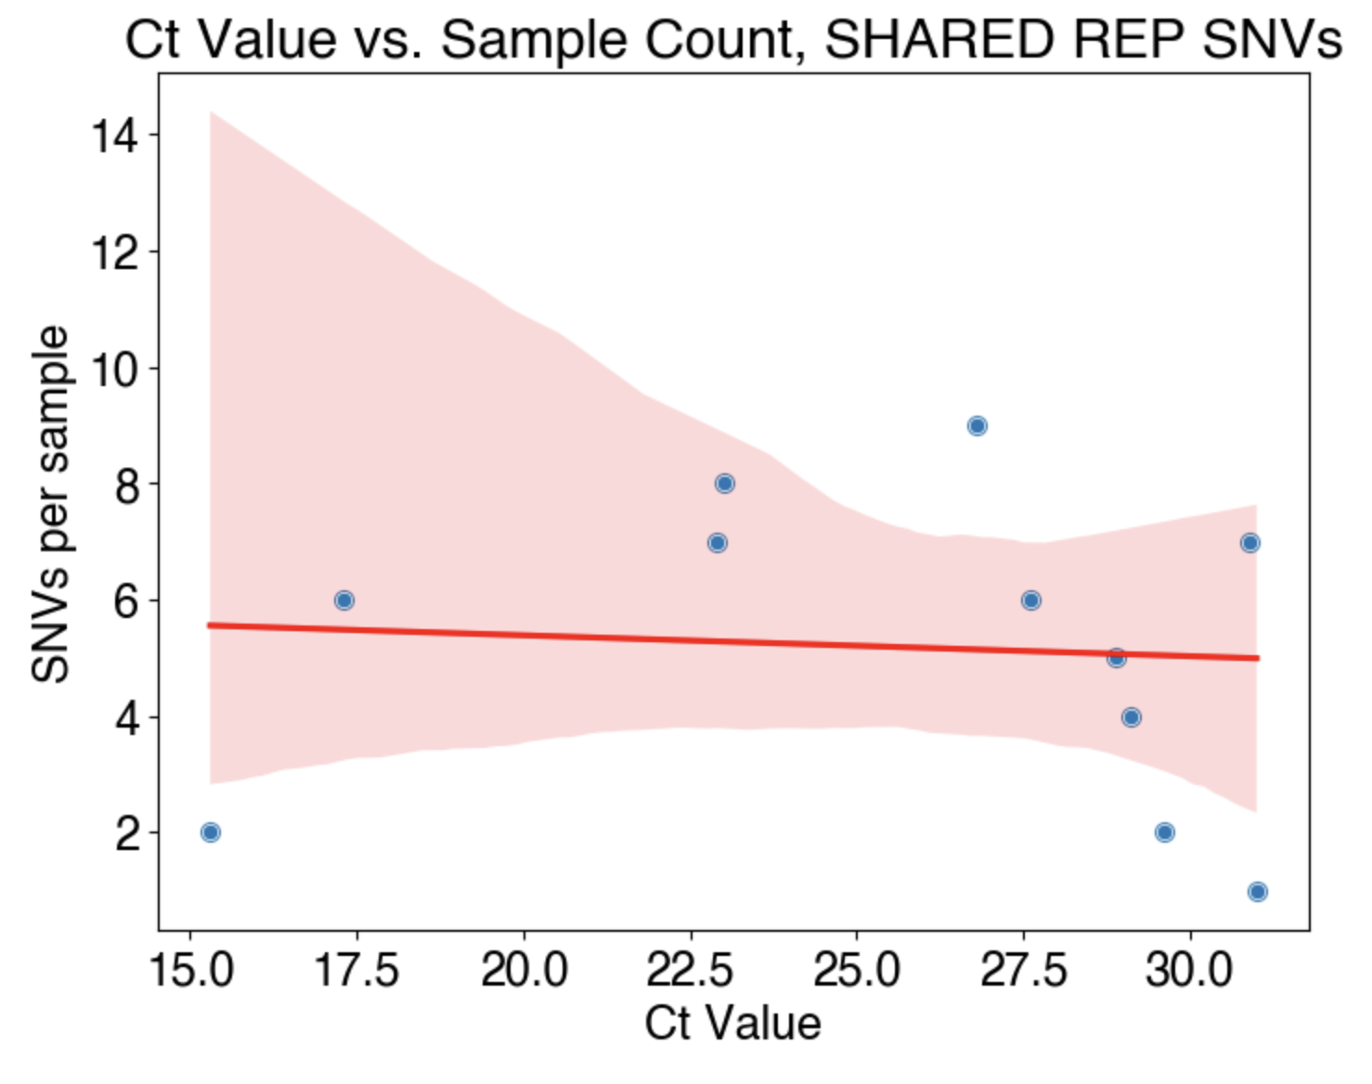

Slide 15
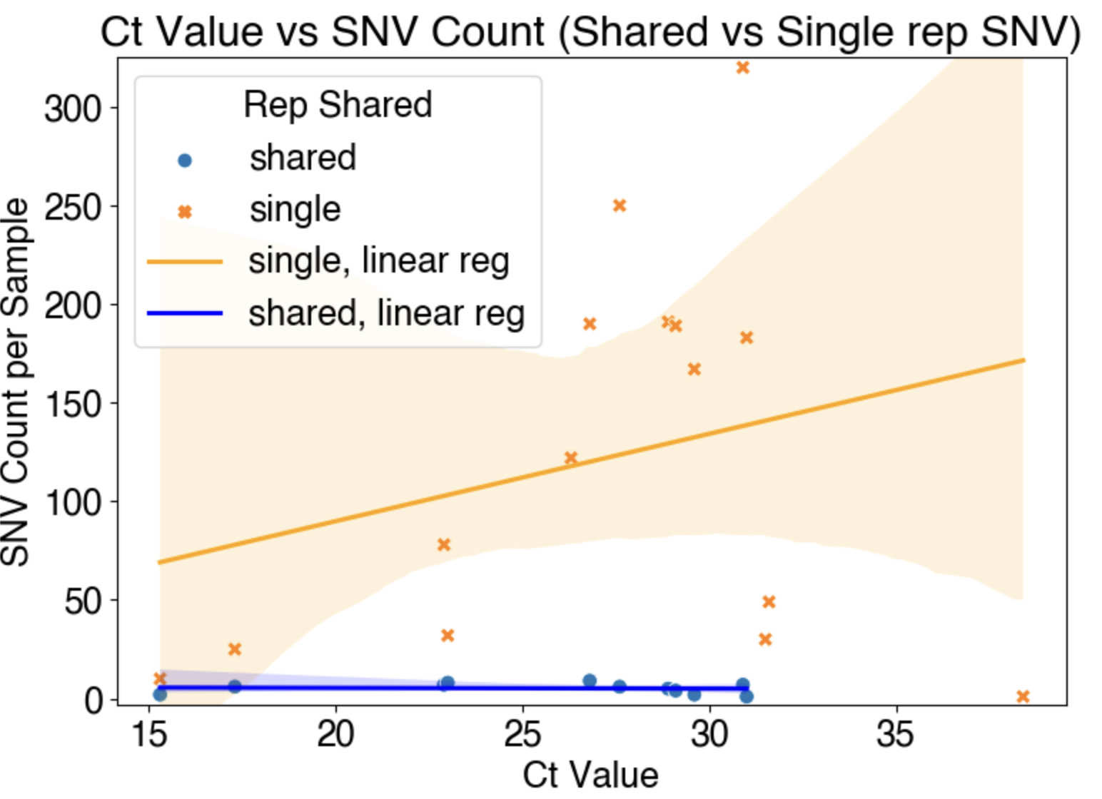

Slide 16
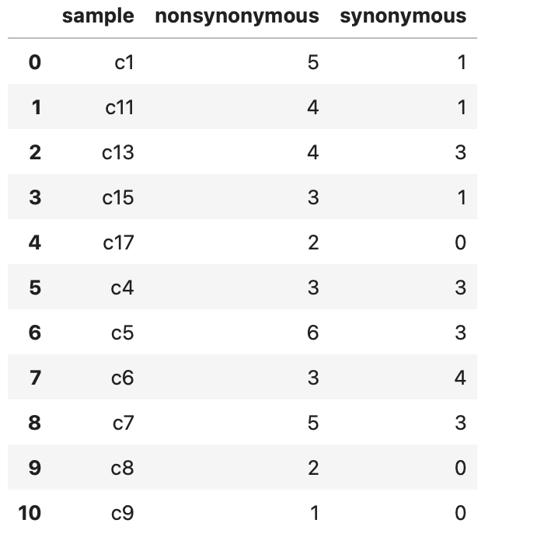
Nonsyn/syn variants shared between replicates

Slide 17
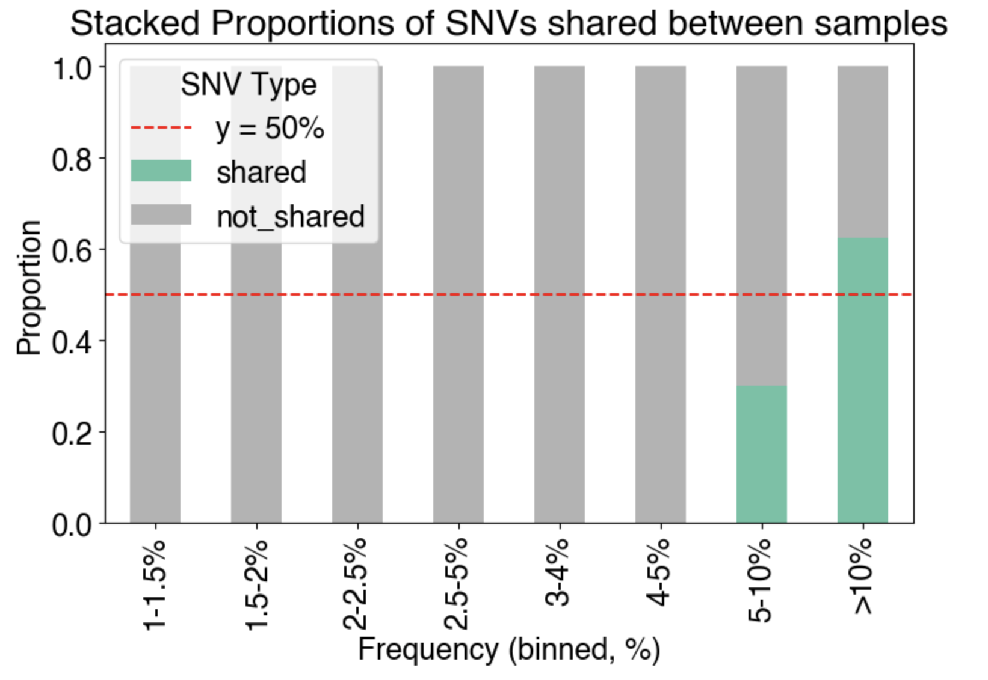
Looking at variants SHARED between replicated – are they also shared between canine samples?
*there are 57 shared variants
*only variants with a frequency of >5% are shared between samples

Slide 18
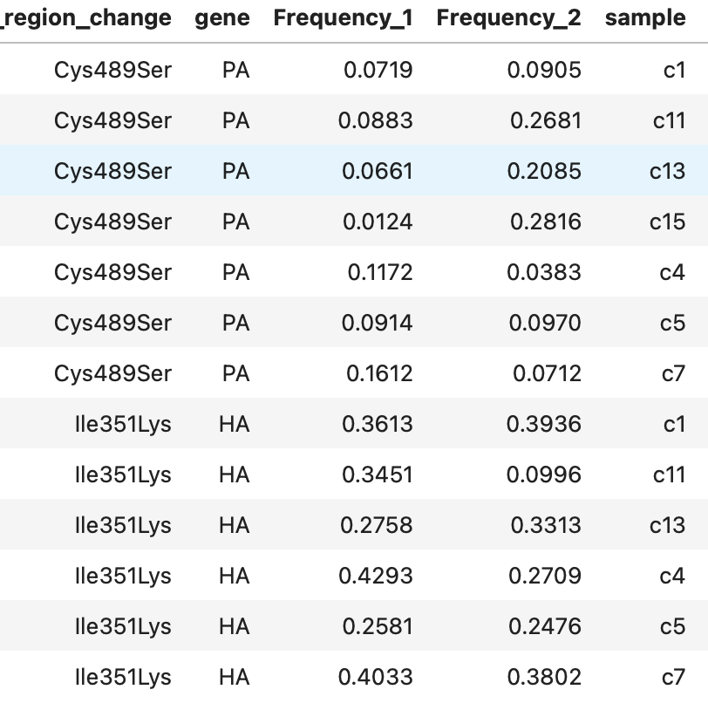
Only 2 mutations appear in more than one sample:
HA Ile351Lys – 7 samples
High freq
Nonpolar to positively charge
PA Cys489Ser – 6 samples
Nonpolar to uncharged polar

Slide 19
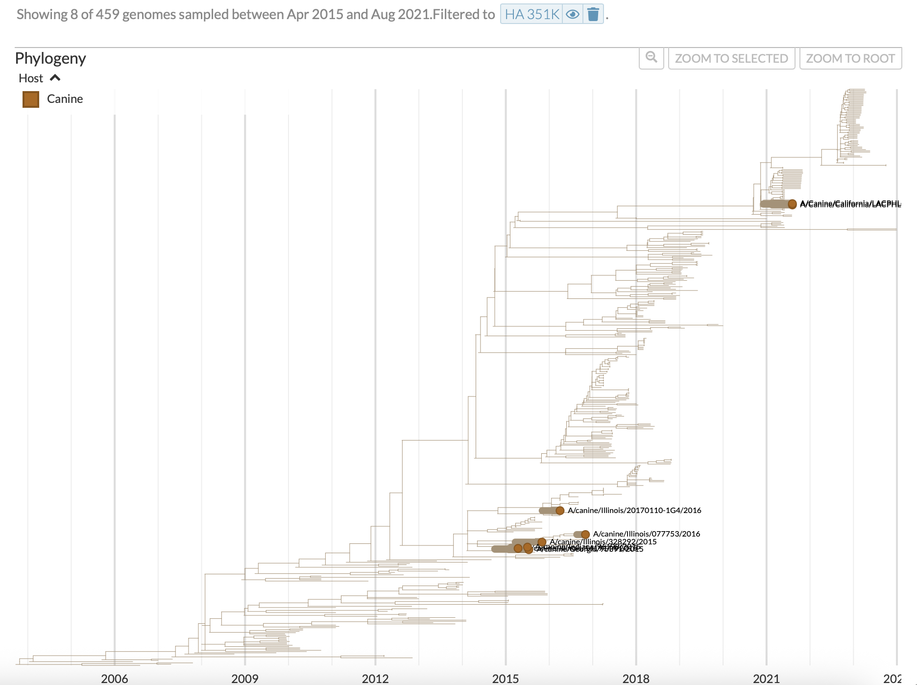
HA H3Nx tree
HA Ile351 is conserved across tree
Consensus base for our canine samples
HA Lys351 only present in a few canine samples

Slide 20
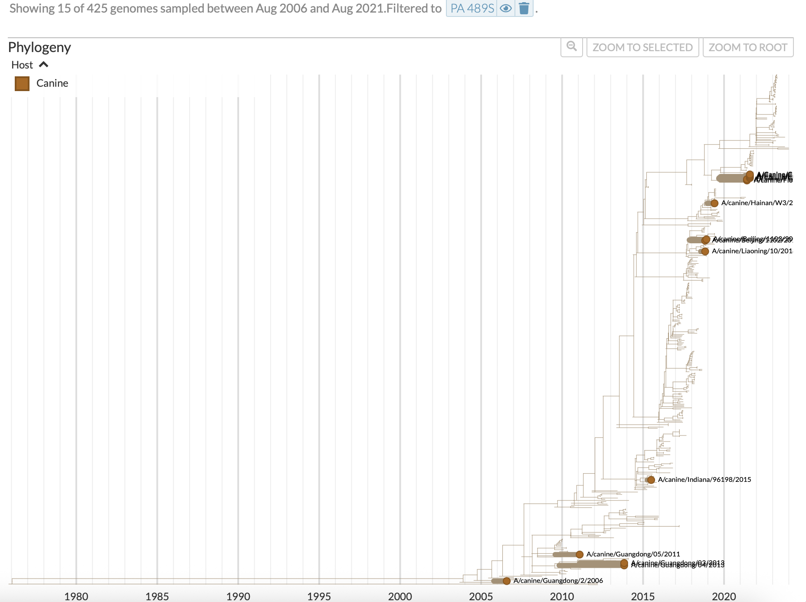
PA H3Nx tree
PA Cys489 is conserved across tree
Consensus base for our canine samples
PA Ser489 only present in a few canine samples

Slide 21
C18 and C19
Border patrol dogs
These samples at consensus level are most diverged from other samples

Slide 22
